Slide 1
Emotional Design Session #08
Course : GAME6012/ User Experiences
Effective Period : September 2017

Slide 2
These slides have been adapted from: Julie A. Kientz (2014). User Experience Design, University of Washington.
Acknowledgement

Slide 3
Learning Objectives

Slide 4
Emotional Design
Emotional Design; also called:
Hedonic Design
Affective Design
Affective Human Factors Design
Human-Centered Design
Empathetic Design
Quick definition: focuses on the influence of emotions on the way we interact with objects.

Slide 5
Background
Multidisciplinary:
Information Sciences
Cognitive Science
Computer Science
Artificial Intelligence
Philosophy
Art & Design
Software & Game Development

Slide 6
Background
Where did it come from?
Human Factors / Ergonomics
Human-Computer Interaction
Why is it a separate field?
Ask Descartes and Aristotle
Rational vs. Emotional
Objective vs. Subjective

Slide 7
Background
Contests classic approaches that treat human behavior as ‘stimulus-response’ and consider emotions as noise

Slide 8
Emotional Design Principle
People will forgive shortcomings, follow your lead, and sing your praises if you reward them with positive emotion.

Slide 9
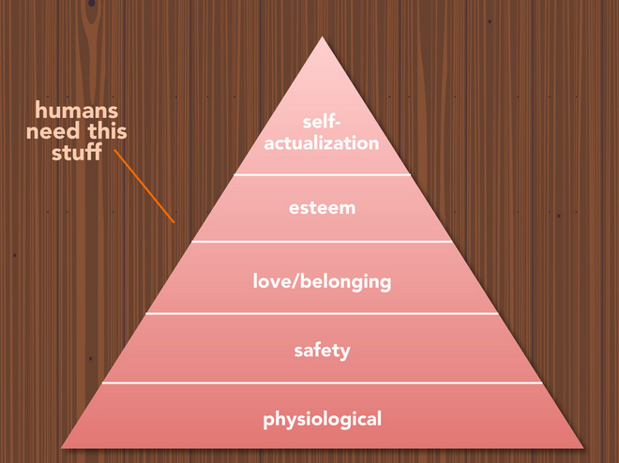
Maslow’s Hierarchy

Slide 10
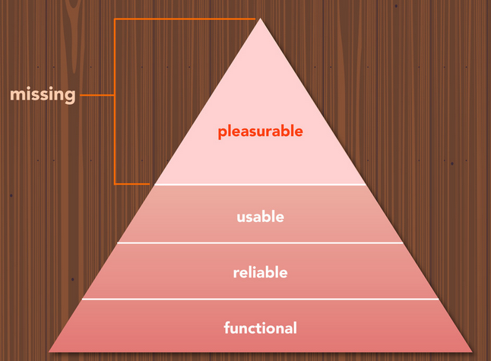
It’s often missing in design

Slide 11
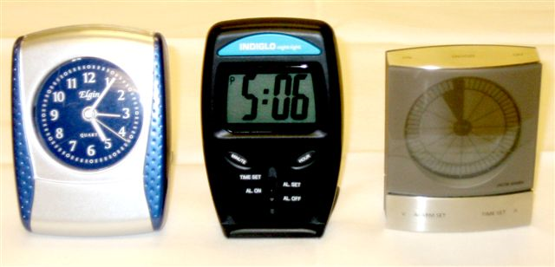
Emotional Design Examples
Gidget: http://gidget.ischool.uw.edu/
Feathers Twitter app: http://feathersapp.com
MailChimp: http://mailchimp.com

Slide 12
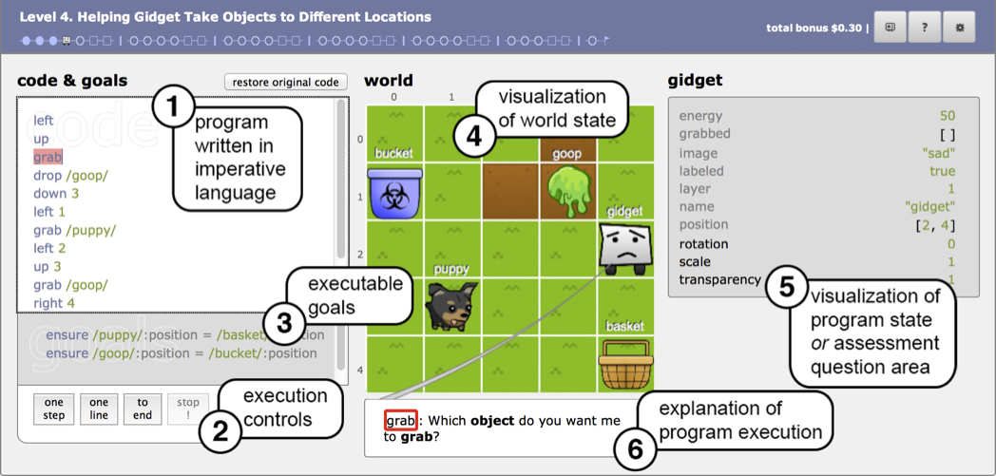
Gidget

Slide 13
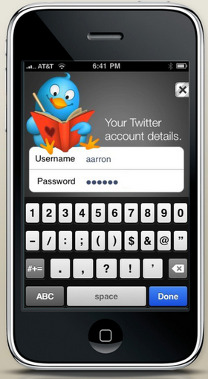
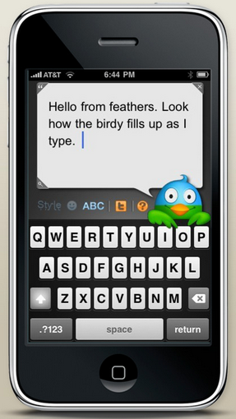
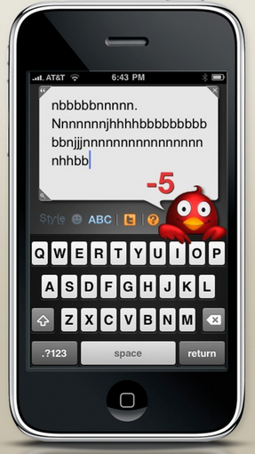
Feathers

Slide 14
Feathers: User Reactions
“I really *LOVE* the singing bird when you send a tweet. Twitter is fun all of a sudden.”
“Confession: sometimes I make too long Feathers-tweets just to watch the bird turn red.”

Slide 15
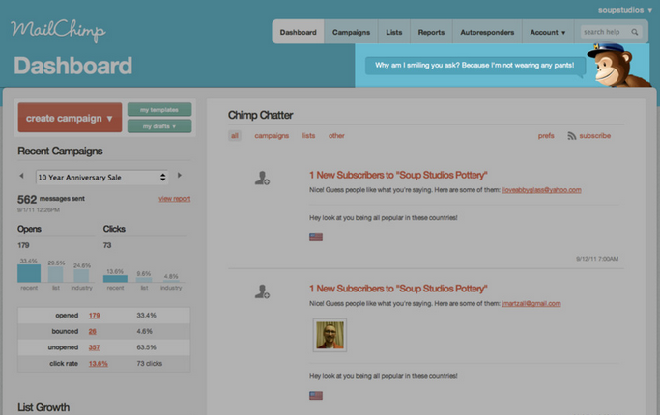
MailChimp
“Oh MailChimp monkey. Just as I get frustrated w/ wrangling
email addresses, you’re there w/ your little witticisms to cheer me up.”

Slide 16
3 Divisions
Niels Engelsted:
Affect (environmental response)
Emotion (based on memory)
Sentiment (long-term, love and hate)
Donald Norman:
Visceral Design (evolutionary responses)
Behavioral Design (bodily activity)
Reflective Design (mental activity)

Slide 17
Design – 3 levels
Designing for Norman’s 3 levels:
Visceral design -> product appearance
Behavioral design -> usability
Reflective design -> self-image
Google: playful, anti-corporate
Apple’s iPhone: stylish, avant-garde

Slide 18
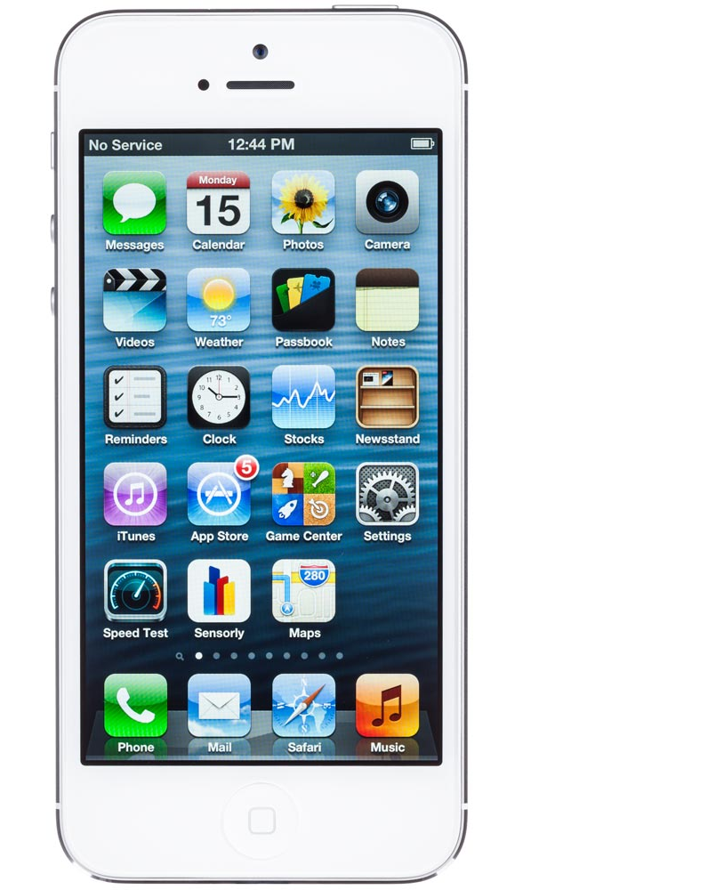
iPhone
Visceral (beauty)
Behavioral (usability)
Reflective (pride of ownership)

Slide 19
Assignment
discuss the visceral, behavioral, and reflective characteristics of the following products
Facebook
Kaskus
Tokopedia
Bukalapak
How about the connection with a game?

Slide 20
References
Buxton, William. 2007. Sketching user experience. Elsevier
Anderson, Stephen. 2011. Seductive Interaction Design. New Riders.
Faranello, Scott. 2016. Practical UX Design. Packt Publishing

